Slide 1

An Open Seminar on
“ Detecting Vishing Attacks in Digital Communication Using Machine Learning ”
Presenter:
Arafat Rahman
ID No: 0322310105101052
B.Sc in CSE
Department of Computer Science and Engineering, PUB.
May, 2025.

Slide 2
A Thesis Proposal Presentation on
“ Detecting Vishing Attacks in Digital Communication Using Machine Learning ”
Supervisor:
Lecturer, Nahid Hasan
Dept. of Computer Science and Engineering, PUB.
Presenter:
Arafat Rahman
ID No: 0322310105101052
B.Sc in CSE
Department of Computer Science and Engineering, PUB.
May, 2025.

Slide 3
Outlines
Introduction
Objectives
Literature Review
Problem Statements
Proposed Methodology
Dataset
Expected Outcome
Conclusion
Reference

Slide 4
Introduction
Vishing attacks exploit voice-based digital communication to deceive users into sharing sensitive information, undermining trust in digital platforms. Machine learning-based detection systems analyze audio and text patterns to identify and prevent such threats, enhancing cybersecurity.
In Bangladesh, where digital literacy is still developing, many individuals are vulnerable to such attacks. The growing number of mobile and online service users makes it critical to develop intelligent systems that can detect and prevent vishing attempts in real time.

Slide 5
Objectives
Develop an automated system capable of detecting vishing attempts in digital communication using supervised machine learning models.
Build a dataset of labeled vishing and non-vishing messages through data collection and preprocessing techniques.
Ensure the system is scalable and adaptable to handle multilingual data and evolving vishing tactics in real-world scenarios.
Design an efficient detection framework optimized for low latency and scalability, ensuring accessibility for diverse linguistic contexts, including Bangla-speaking users.

Slide 6
Literature Review (1/4)
Title: Boussougou et al. (2025) [1] explored multilingual back-translation and SMOTE techniques to enhance voice phishing detection using machine learning.
Contribution:
Introduced multilingual back-translation (BT) with SMOTE to handle data imbalance.
Used KorCCVi v2 dataset (2,927 samples).
Achieved F1-score of 98.91% (BT), 100% accuracy (CNN & RF).
Limitation:
High computational cost.
BT may introduce noise.
Overfitting observed in some models (e.g., CNN).

Slide 7
Literature Review (2/4)
Title: Mahmud et al. (2024) [2] – Hybrid Deep Learning Approaches to Smishing Detection
Contribution:
Proposed a CNN-Bi-GRU hybrid model for detecting smishing in SMS.
Achieved 99.82% accuracy and 98.56% F1-score on benchmark datasets.
Used Word2Vec and LIME to identify important phishing indicators like urgent and free.
Limitation:
Datasets are English-only and imbalanced.
Computationally heavy for real-time use.
No real-time deployment or live testing was done.

Slide 8
Literature Review (3/4)
Title: Lee et al. (2025) [3] – Early-Stage Vishing Detection via Runtime Permissions.
Contribution:
Proposed VishielDroid, a real-time Android vishing detector using runtime permission requests.
Achieved 99.86% accuracy and 99.78% F1-score using SVM.
Lightweight model with minimal memory and battery usage, tested on Android 12.
Limitation :
Depends on app execution—may miss delayed threats.
Requires Android OS modifications.
No real-world user interaction testing.
May not detect colluding apps that split malicious behavior.

Slide 9
Literature Review (4/4)
Title: Mehmood et al. (2024) [4] – Deep Learning Approach for Voice Spoofing Detection in ASV Systems.
Contribution:
Developed a DBiLSTM-based system using ELTP-LFCC feature fusion for detecting spoofed voice in speaker verification.
Achieved 0.74% EER and 0.008 t-DCF, outperforming baseline methods.
Highly effective against TTS attacks (EER: 0.002%).
Limitation :
Poor performance on voice conversion attacks (EER: 33.28%). Requires Android OS modifications.
Generalizability limited to ASVspoof 2019 dataset.
High computational cost may hinder real-time use.

Slide 10
Problem Statements
Most vishing detection research relies on English-language datasets, leading to poor performance when applied to Bangla communication.
There is a lack of publicly available, labeled Bangla datasets for vishing or phishing-related messages, making it difficult to train effective models.
Existing models are not optimized for the linguistic nuances of Bangla, leading to high false positives and false negatives in real-world scenarios.
Many vishing detection frameworks rely on computationally intensive models, making them impractical for real-time deployment on resource-constrained devices.

Slide 11
Proposed Methodology
Dataset Preparation
Feature Extraction
Word-Level Recognition
System Optimization
Evaluation & Validation

Slide 12
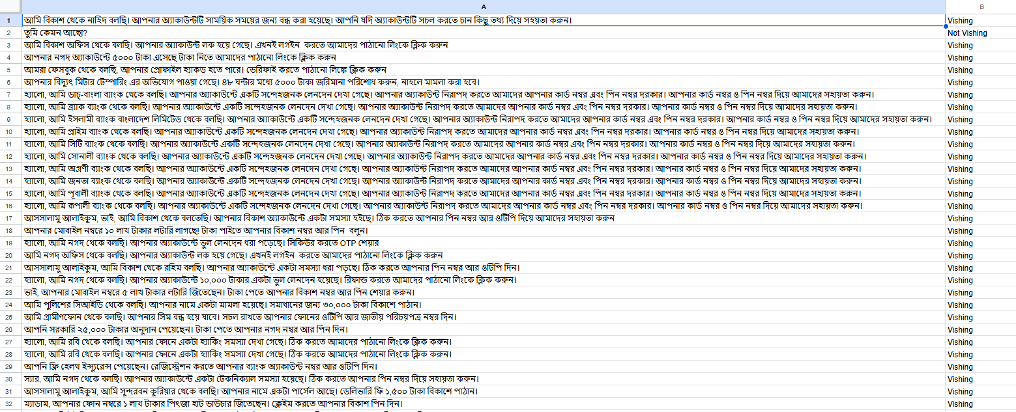
Dataset
Vishing Detection Dataset: A labeled Bengali-language dataset developed to detect vishing (voice phishing) attacks.
Total Data: 2100
Total Class: 2 (Vishing, Not Vishing)
Size on Disk: 472 KB
Own created Video Dataset

Slide 13
Expected Outcome
Real-time detection on mobile devices with a lightweight model suitable for low-resource environments.
Minimize false positives and false negatives, ensuring more reliable classification of phishing vs. legitimate messages.
Support for multilingual data, focusing on Bangla text-based vishing attacks.
Adaptability to evolving attack strategies, creating a scalable and future-proof detection framework.

Slide 14
Conclusion
This research aims to address the growing threat of text-based vishing attacks by developing a robust, lightweight, and intelligent detection system. By leveraging hybrid deep learning models and focusing on Bangla (বাংলা) language support, the system will enable more inclusive and accurate protection against phishing messages in local contexts. With real-time detection capabilities and adaptability to evolving attack patterns, the proposed approach contributes to enhancing mobile cybersecurity, especially for Bangladeshi users who are often underserved by existing solutions.

Slide 15
References
Boussougou, M. K. M., Hamandawana, P., & Park, D. J. (2025). Enhancing Voice Phishing Detection Using Multilingual Back-Translation and SMOTE: An Empirical Study. IEEE Access.
Mahmud, T., Prince, M. A. H., Ali, M. H., Hossain, M. S., & Andersson, K. (2024). Enhancing Cybersecurity: Hybrid deep learning approaches to smishing attack detection. Systems, 12(11), 490.
Lee, C., Kim, B., & Kim, H. (2025). The silence of the phishers: Early-stage voice phishing detection with runtime permission requests. Computers & Security, 104364.
Mehmood, M. K., Arshad, H., Alawida, M., & Mehmood, A. (2024). Enhancing Smishing Detection: A Deep Learning Approach for Improved Accuracy and Reduced False Positives. IEEE Access.

Slide 16
Thank You.
Do you have any questions?

